Slide 1


Computech Corporation: Advanced Job and Candidate Application
Development Plan
Simul Kadakia, Wesley Trescott, Gagandeep Singh
2/3/2015

Slide 2


Project Overview
Computech uses a recruiting management system called Pinpoint
Lacks an attractive job search and application site
Our project creates a web application for WSU students (and, eventually, others) to search and apply for positions at Computech

Slide 3
Project Purpose, Scope, Objectives
Create a secure web portal for WSU students to search for jobs based on their skill sets
Users can save and re-access their information, such as e-mail address and experience and (optionally) upload resumes
Users can filter job searches based on location, experience required, and industry
To apply, users can either manually enter fields or populate fields from their previously saved data; jobs matching users’ experience are automatically suggested to the user
Have an admin mode to control user account information
The web application is not specific to a particular device and should be accessible from desktop and mobile environments

Slide 4
Team Organization
Simul Kadakia—Team Lead, DB Design and Connectivity
Coordinate communication with the client
Ensure work is completed on time
Complete work on the database and its backend connection to the application
Gagandeep Singh—Controller and Application Logic
Implement the core logic of the application
Wesley Trescott—Application View and Frontend
Program the user interface of the application
The team will collaborate on documentation, testing, and presentations

Slide 5
Problem Resolution Policies
If a team member has difficulty with a technical problem, the group will work together to solve the issue, consulting the T.A. if necessary
If a team member doesn’t produce the required work on time, or fails to attend a meeting:
Team lead contacts team member about the issue and notifies T.A.
Other team members will collaborate to complete the missing work to the best of their abilities
There will be no foreseeable technology-related disputes, since the client has already dictated the technologies to be used

Slide 6
Project Plan—Iterations
The project will be completed in three phases:
Phase 1 - Due 2/27/2015
Database design
Website page layout
Basic website functionality, connect to database
Testing of prototype application
Phase 2 - Due 3/24/2015
Filtering functions to filter job search results
Data retrieval techniques to retrieve results based on user input
Testing of filtering, data retrieval, and system functionality
Phase 3 - Due 4/9/2015
All features implemented successfully
Rigorous functional and non-functional testing of application
Web application deployed on Computech Server

Slide 7


Project Plan—Additional Info
Deliverables: there will be a deliverable after each phase
1st Deliverable: First prototype application
2nd Deliverable: Second prototype application
3rd Deliverable: Final, complete application
Meetings
Group meetings:
Our group will meet amongst ourselves each Tuesday before the client meeting to discuss project progress
Client meetings:
Our group will meet with the client at Computech every Tuesday

Slide 8
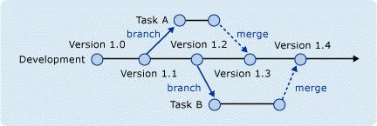

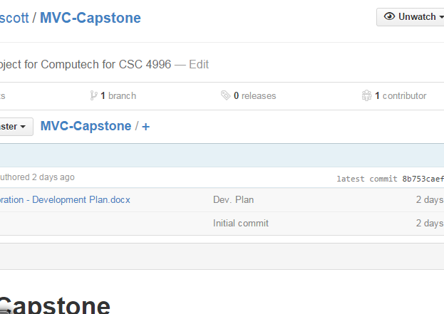
Configuration Management
We will be using GitHub for as a repository and source control system
Single branch
Each member works on assigned parts
No conflicts with others’ code

Slide 9


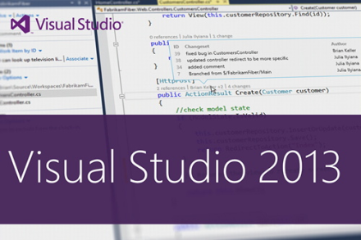
Technologies
Microsoft ASP .NET 4.5 (MVC, Entity Framework, LINQ)
Framework to be used to create the web application with database connectivity
Microsoft SQL Server
Database management system to hold applicants’ data
Visual Studio
Integrated development environment to code the application
C#, JavaScript (jQuery), CSS, HTML (Razor)
Languages used in the application controller and frontend
→All technologies dictated by client

